Slide 1
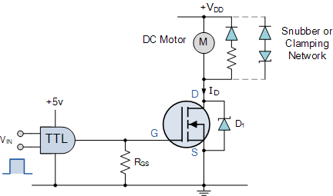
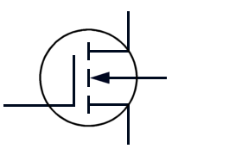
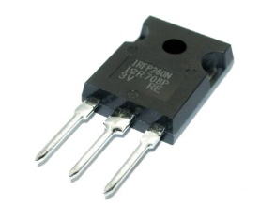
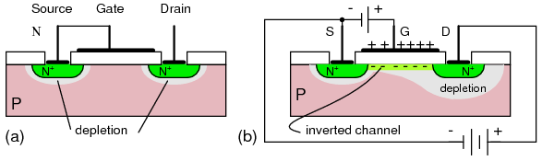
MOSFET

Slide 2
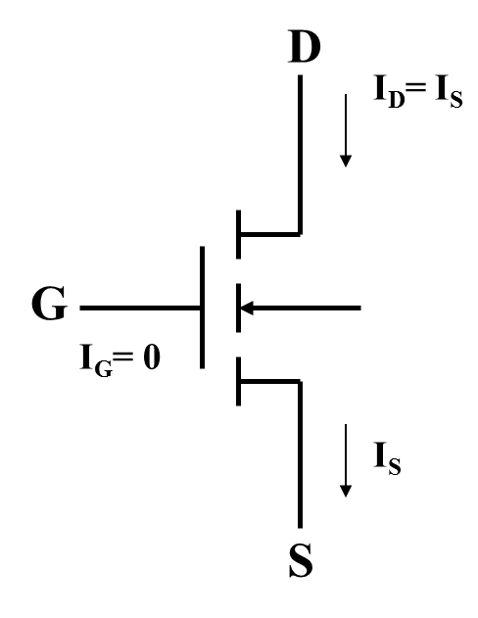
MOSFET
MOSFET stands for metal-oxide semiconductor field-effect transistor.
Unlike BJT which is ‘current controlled’, the MOSFET is a voltage controlled device.
The MOSFET has “gate“, “Drain”, “Source” and “Body” terminals.
G-Gate
D-Drain
S-Source
B-Substrate or Body

Slide 3
Types of MOSFETS
n-channel Enhancement Mode (nMOSFET) | p-channel Enhancement Mode (pMOSFET)
n-channel Depletion Mode (nMOSFET) | p-channel Depletion Mode (pMOSFET)

Slide 4
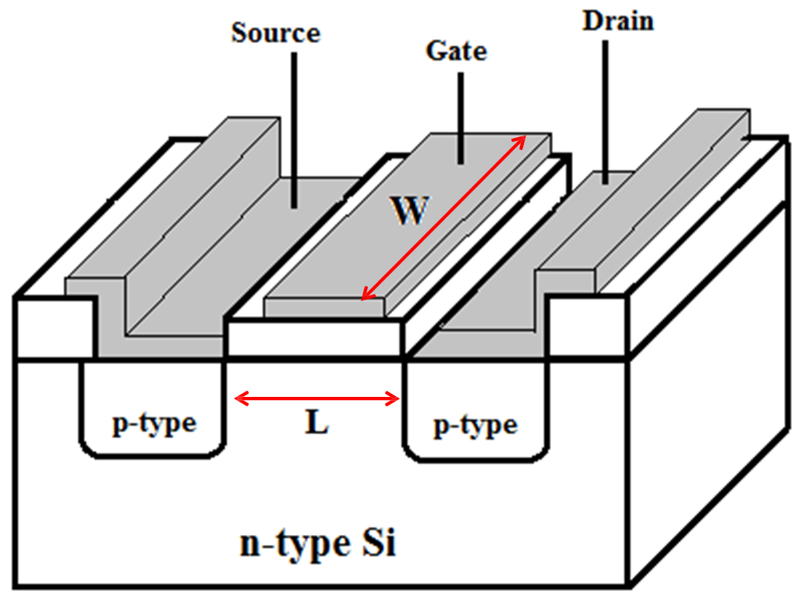
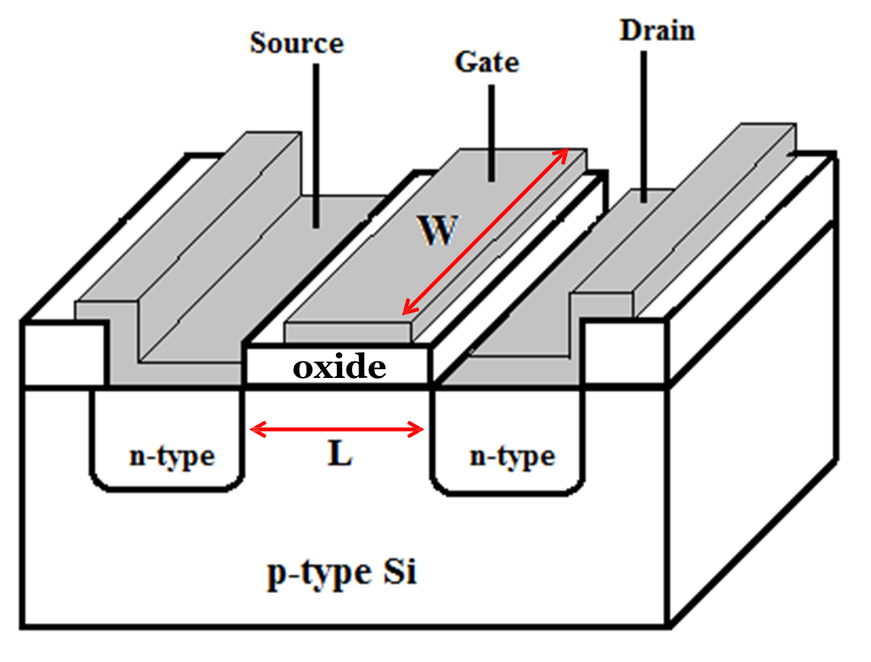
Cross-Sectional View of n channel Enhancement Mode Transistor
Cross-Sectional View of p channel Enhancement Mode Transistor
Enhancement mode
Also known as Normally Off transistors.
▫ A voltage must be applied to the gate of the transistor, at least equal to the threshold voltage, to create a conduction path between the source and the drain of the transistor before current can flow between the source and drain.

Slide 5
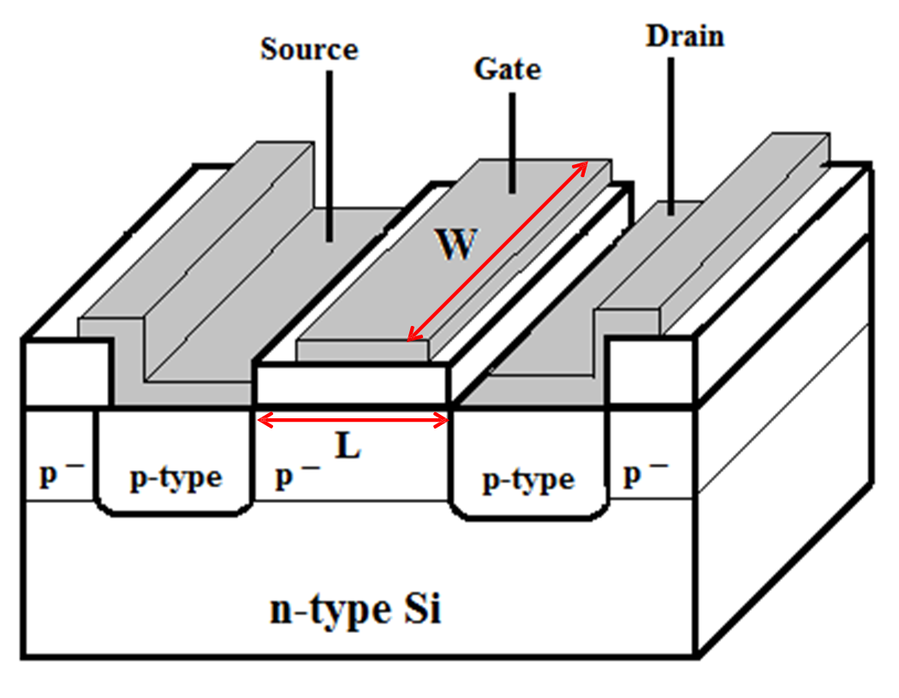
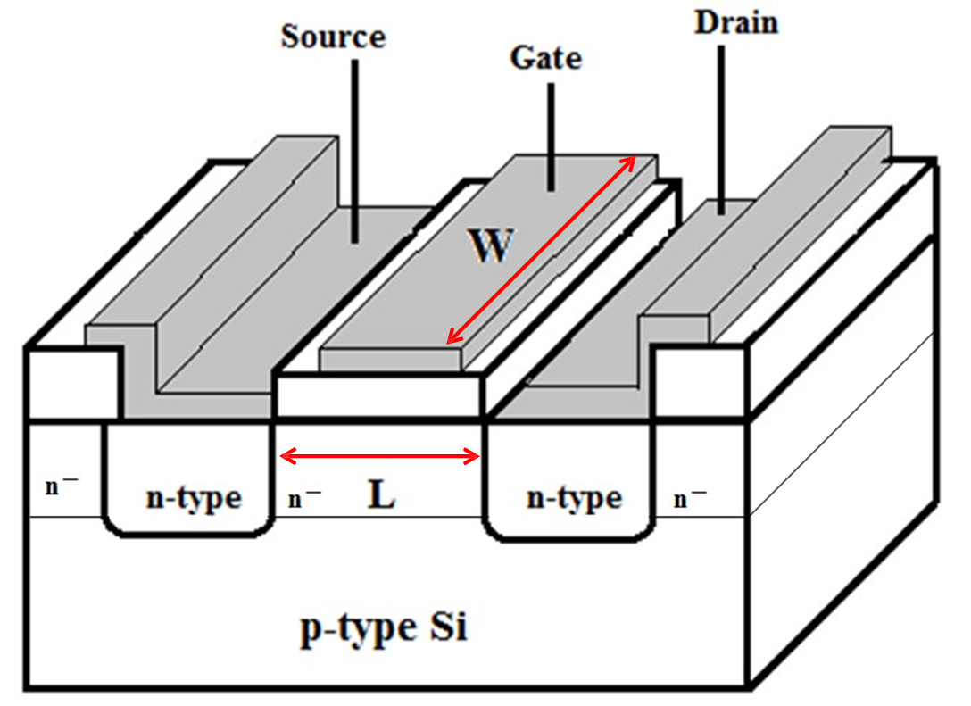
p channel Depletion Mode Transistor
n channel Depletion Mode Transistor
Depletion mode
Also known as Normally On transistors.
A voltage must be applied to the gate of the transistor, at least equal to the threshold voltage, to destroy a conduction path between the source and the drain of the transistor to prevent current from flowing between the source and drain.

Slide 6
Operation of a Enhancement mode transistor
A voltage must be applied to the gate of the transistor, at least equal to the threshold voltage, to create a conduction path between the source and the drain
V_{GS} > 0
n type operation
V_{GS}
Gate
V_{SD}
Insulator
Source
Channel
Drain
More
electrons
Substrate
Positive gate bias attracts electrons into channel.
Channel now becomes more conductive

Slide 7
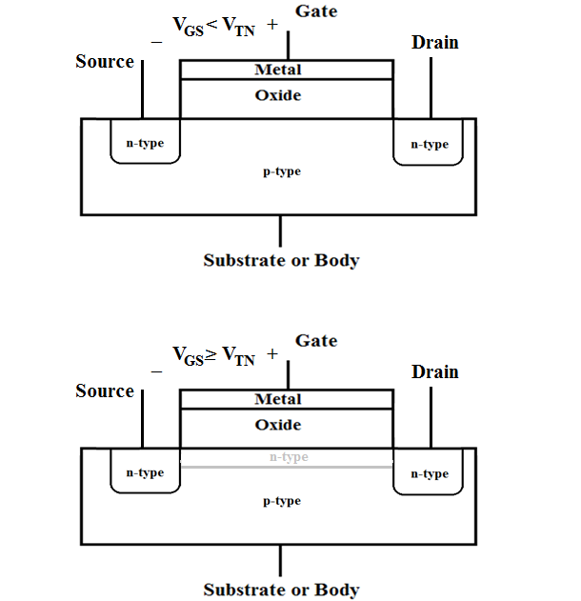
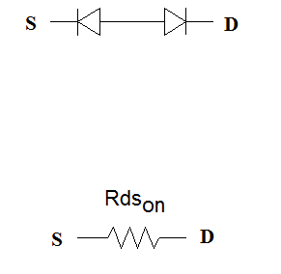
Before electron inversion layer is formed
(Enhancement mode)
With no bias voltage applied to the gate terminal, there exists two back-to-back pn junctions between the drain and the source. No current flows from drain to source (the resistance will be on the order of 10¹² Ω).
After electron inversion layer is formed

Slide 8
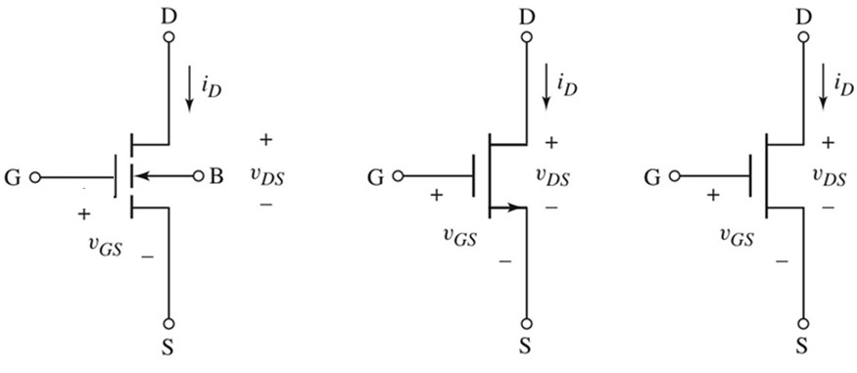
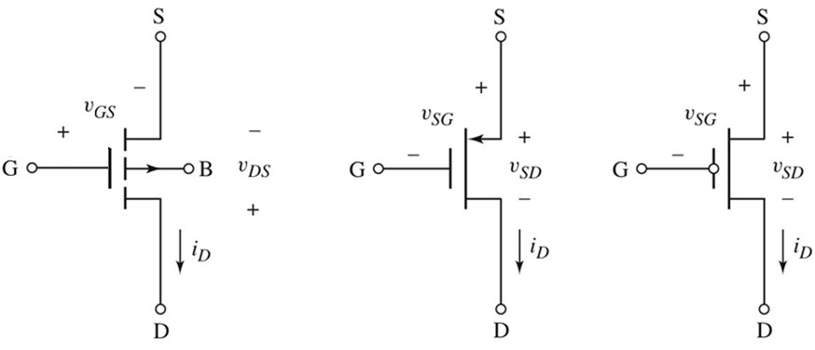
Symbols for n channel Enhancement Mode MOSFET
V_{GS} ≥ 0V, V_{DS} ≥ 0V
V_{TN} is positive
Symbols for p channel Enhancement Mode MOSFET
V_{GS} ≤ 0V, V_{DS} ≤ 0V
V_{TP} is negative

Slide 9
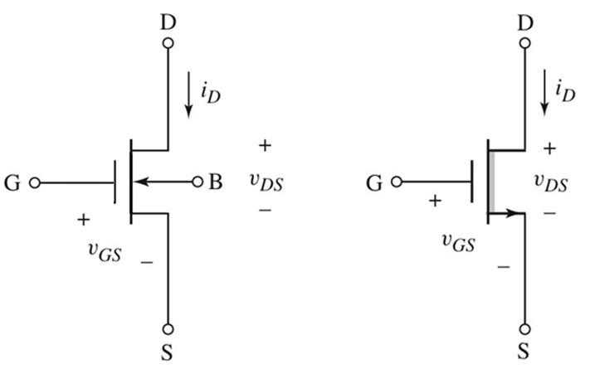
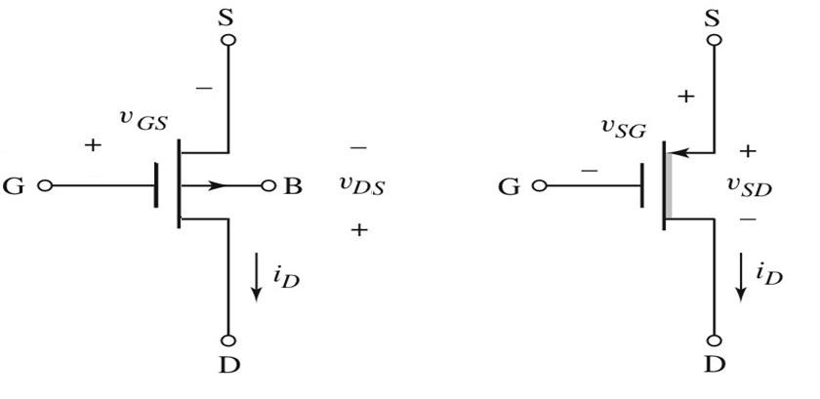
Symbols for n channel Depletion Mode MOSFET
Symbols for p channel Depletion Mode MOSFET

Slide 10
Working Modes
(Enhancement mode)
I_{D}
triode
increasing
V_{GS}
V_{DS}>V_{GS}-V_{T}
V_{DS}<V_{GS}-V_{T}
saturation
V_{DS}
0.1 v

Slide 11
Triode Region A voltage-controlled resistor @small V_{DS}
(Enhancement mode)
Positive gate bias attracts electrons into channel.
B
S
+
D
-
+++
V_{GS1}>V_{t}
I_{D}
+++
increasing
V_{GS}
metal
oxide
p
n+
- - - -
n+
B
S
+
D
-
+++
V_{GS2}>V_{GS1}
+++
+++
metal
G
oxide
p
n+
- - - - - -
n+
V_{DS}
B
S
+
D
cut-off
-
0.1 v
+++
V_{GS3}>V_{GS2}
+++
+++
+++
metal
Increasing V_{GS} puts more charge in the channel, allowing more drain current to flow
oxide
p
n+
- - - - - - - - -
n+

Slide 12
Saturation Region occurs at large V_{DS}
(Enhancement mode)
As the drain voltage increases, the difference in voltage between the drain and the gate becomes smaller. At some point, the difference is too small to maintain the channel near the drain → pinch-off
gate
G
body
B
source
S
drain
D
-
+
V_{DS} large
+++
+++
+++
metal
oxide
p
n+
n+

Slide 13
Saturation Region occurs at large V_{DS}
(Enhancement mode)
The saturation region is when the MOSFET experiences pinch-off. Pinch-off occurs when V_{G} - V_{D} is less than V_{T}.
gate
G
body
B
source
S
drain
D
-
+
V_{DS} large
+++
+++
+++
metal
oxide
p
n+
n+

Slide 14
Saturation Region occurs at large V_{DS}
(Enhancement mode)
V_{GS} - V_{DS} < V_{T} or V_{GD} <
or V_{DS} > V_{GS} - V_{T}
V_{T}
gate
G
body
B
source
S
drain
D
-
+
V_{D}>>V_{s}
+++
+++
+++
metal
oxide
p
n+
n+

Slide 15
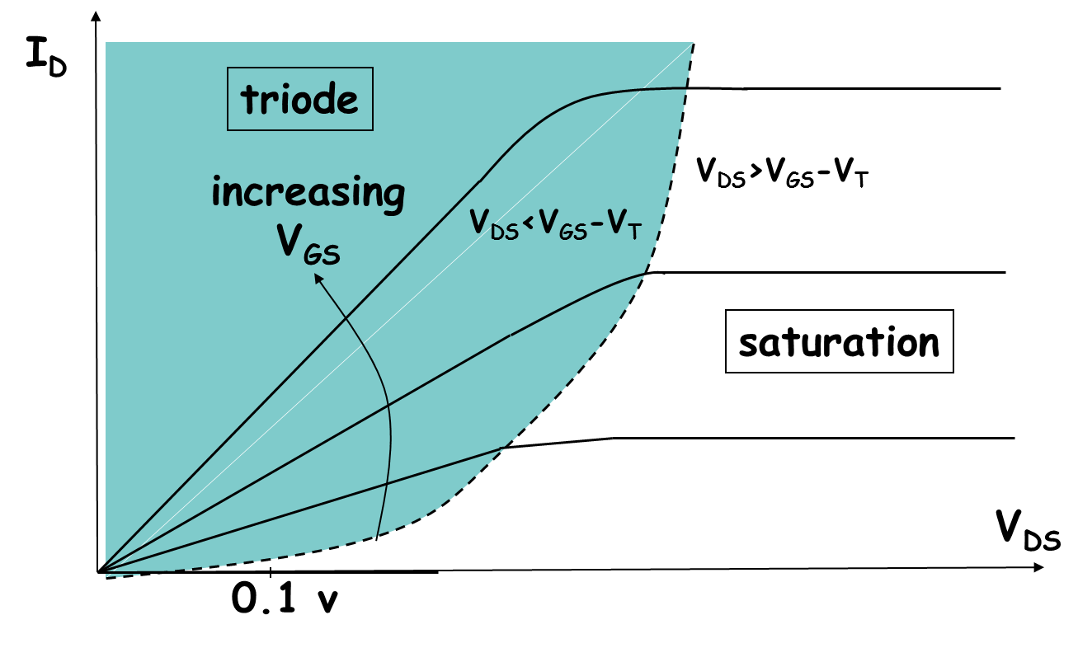
Saturation Region once pinch-off occurs, there is no further increase in drain current
(Enhancement mode)

Slide 16
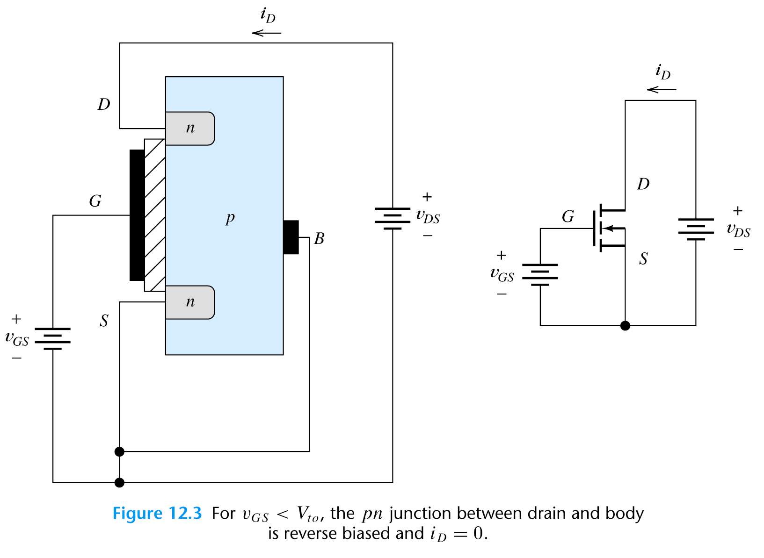
n-channel MOSFET Basic Operation
(Enhancement mode)
Operation in the Cutoff region
pn junction: reverse bias
i_{D}=0
for v_{GS}<V_{t0}
When v_{GS}=0 then i_{D}=0 until v_{GS}>V_{t0} (V_{t0} –threshold voltage)

Slide 17
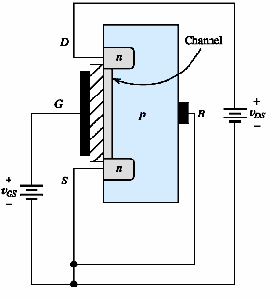
n-channel MOSFET Basic Operation
Operation in the Triode Region
(K is defined by the electrical and physical parameters of the MOSFET)

Slide 18
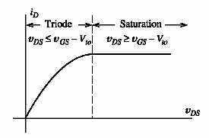
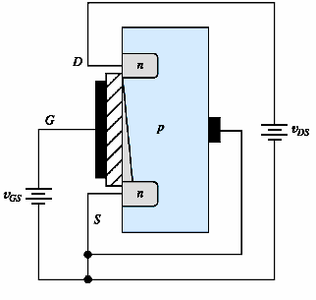
n-channel MOSFET Basic Operation
Operation in the Saturation Region (v_{DS} is increased)
Tapering
of the
channel
- increments
of i_{D} are
smaller
when
v_{DS} is
larger

Slide 19
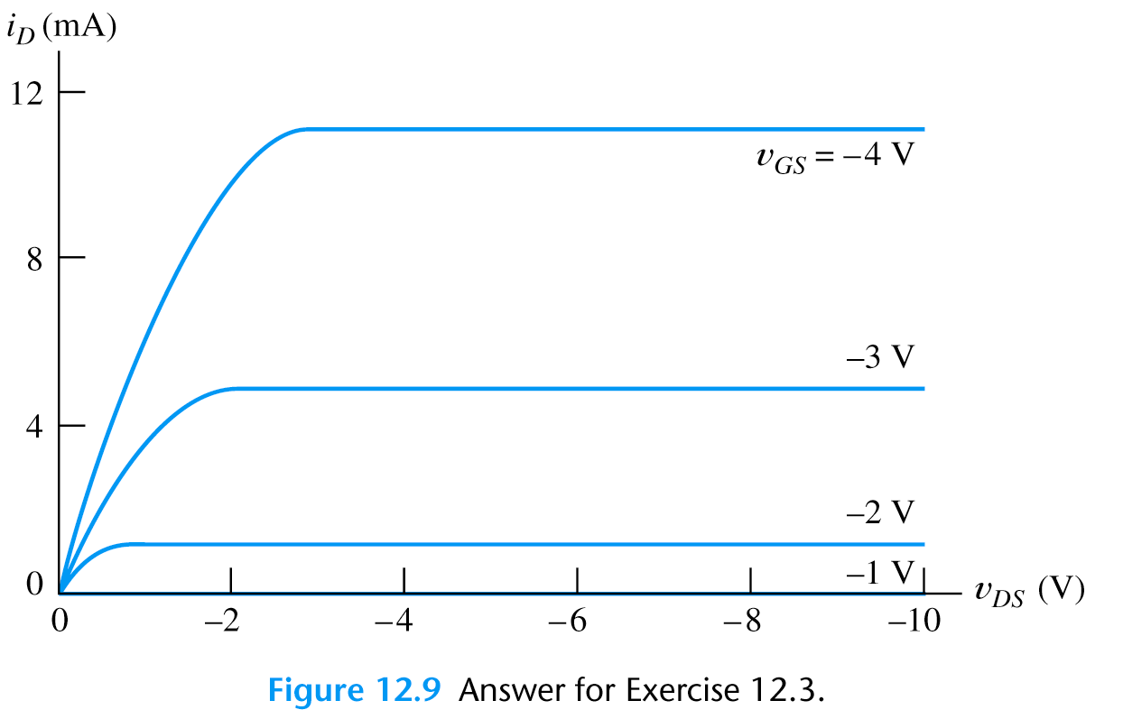
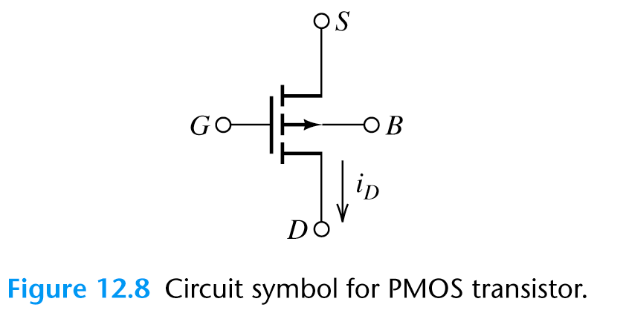
p-channel MOSFET Basic Operation
It is constructed by interchanging the n and p regions of n-channel MOSFET.
Symbol
Characteristic

Slide 20
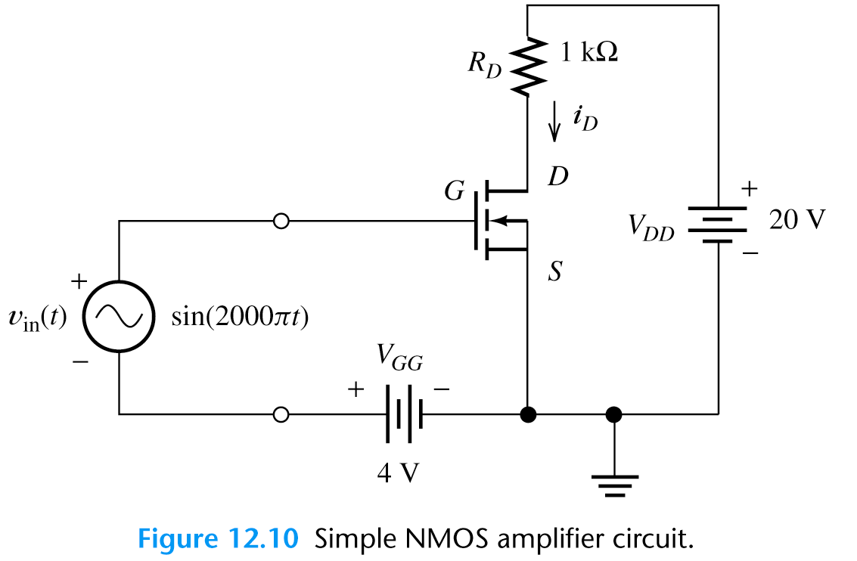
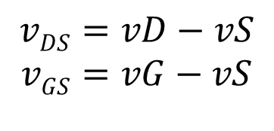
Load-Line Analysis of NMOS Amplifier
It is a graphical analysis similar to load-line analysis of pn diode.
We look for the operating point
Circuit Analysis:
v_{GS}
v_{DS}
Input
loop
Output loop
Load line

Slide 21
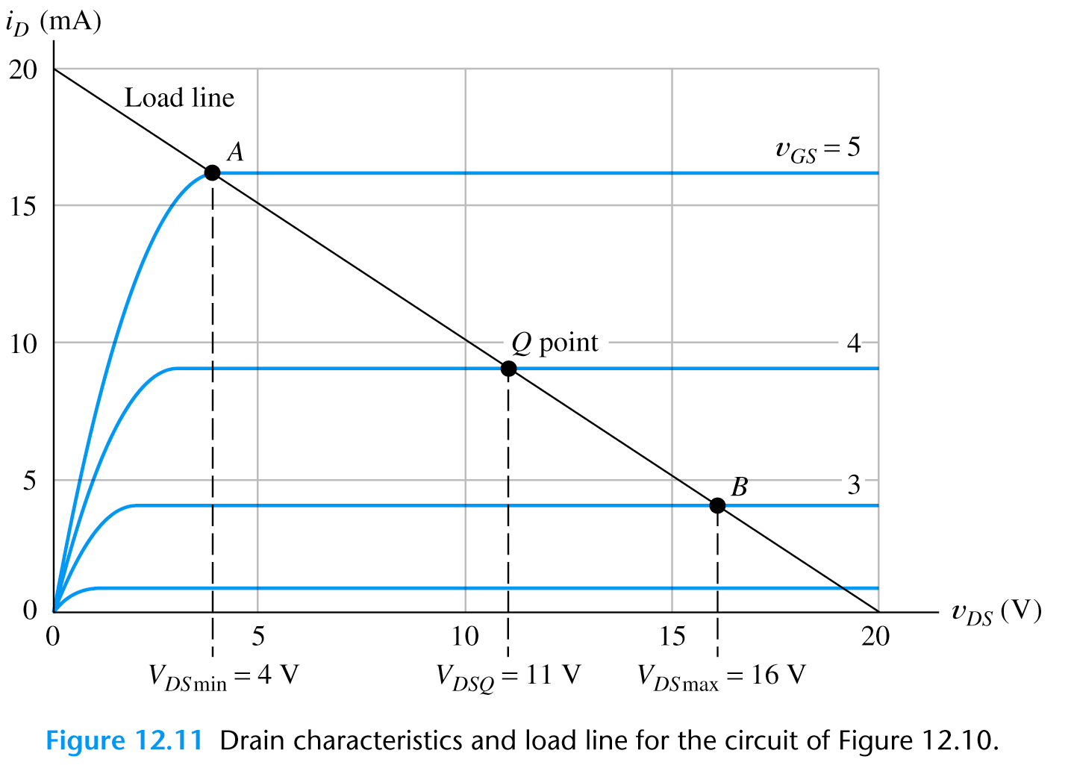
Load-Line Analysis of NMOS Amplifier
Exercise:
Draw the Load line
R_{D}= 1 kΩ

Slide 22
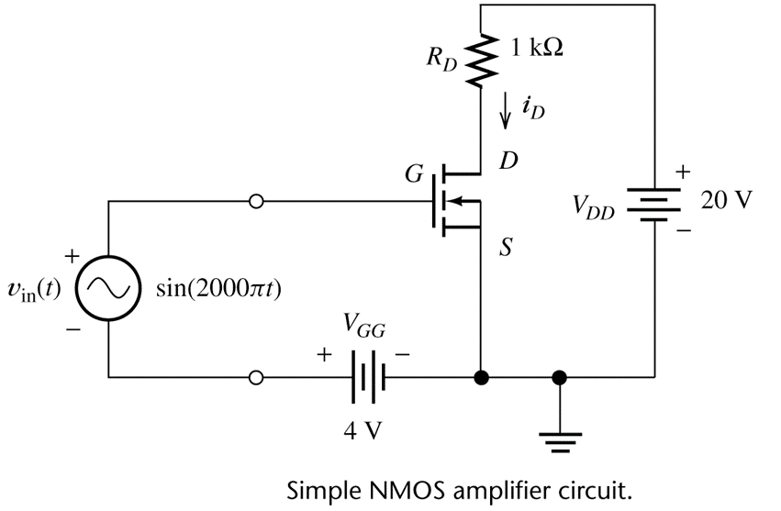
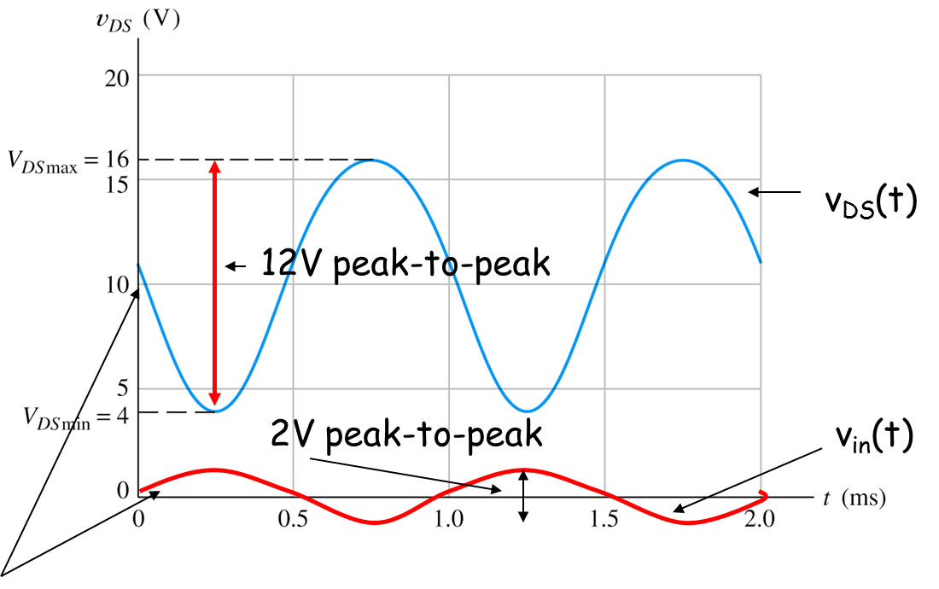
Load-Line Analysis of NMOS Amplifier
Load line
Taking i_{D}=0 or v_{DS}=0 we find out the load line and the operating point Q for V_{GS}=4V
Points A & B intersection of curve and the load-line for the maximum and the minimum gate voltage

Slide 23
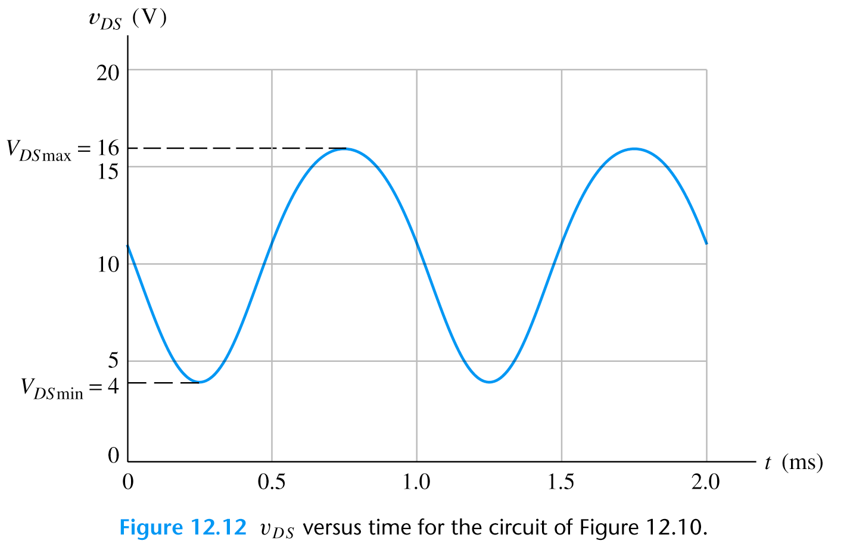
Load-Line Analysis of NMOS Amplifier
Input signal
(peak-to-peak amplitude is 2V)
v_{DS}(t)
12V peak-to-peak
2V peak-to-peak
v_{in}(t)
Inverse operation
The positive peak of the input occurs at the same time as the min. value of v_{DS}. The output is not a symmetrical sinusoid! (nonlinear distortion)

Slide 24
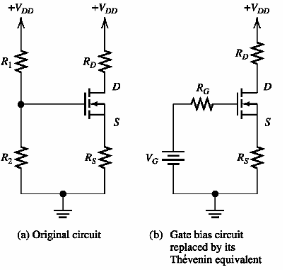
Self Bias Circuits
Analysis of amplifier circuits is often undertaken in two steps:
(1) The DC circuit analysis to determine the Q point. It involves the
nonlinear equation solution or the load-line method. This is called bias
analysis
The fixed-plus self-bias circuit
Exercise:
Find V_{G} voltage as a function of V_{DD}, R₁ and R₂
+
v_{G}
_
Input
Output

Slide 25
Self Bias Circuits
Analysis of amplifier circuits is often undertaken in two steps:
(1) The DC circuit analysis to determine the Q point. It involves the
nonlinear equation solution or the load-line method. This is called bias
analysis
The fixed-plus self-bias circuit
+
v_{G}
_
Input
Output

Slide 26
Self Bias Circuits
Analysis of amplifier circuits is often undertaken in two steps:
(1) The DC circuit analysis to determine the Q point. It involves the
nonlinear equation or the load-line method. This is called bias
analysis
(2) Use a linear small-signal equivalent circuit to determine circuit
parameters
For saturation region
Analysis…
Equivalent circuit
find v_{GS}
v_{DS}
v_{GS}

Slide 27
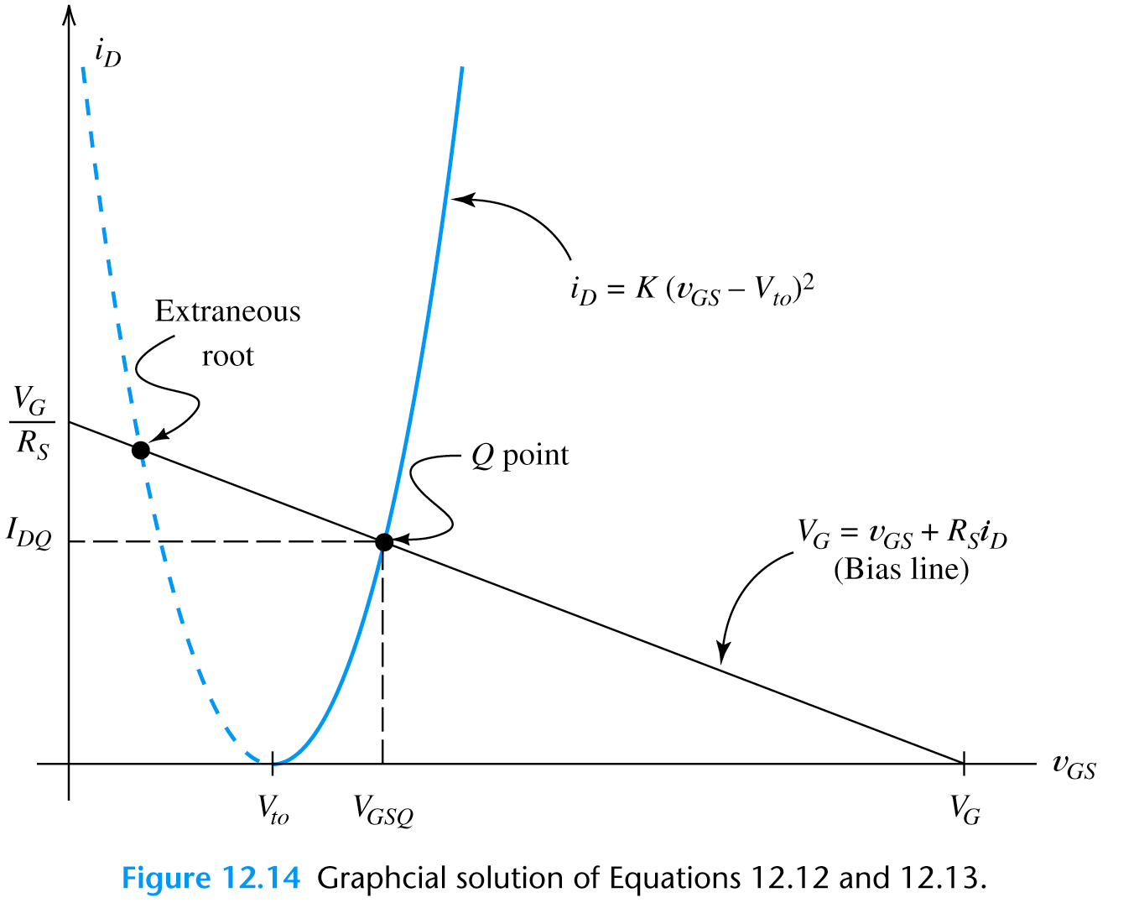
Self Bias Circuits
For saturation region
Plot of
and
Disregarded root for v_{GS}<V_{t0}
Use only larger root for v_{GS} and smaller for i_{D}

Slide 28
Self Bias Circuits
Analysis of amplifier circuits is often undertaken in two steps:
(1) The dc circuit analysis to determine the Q point. It involves the
nonlinear equation or the load-line method. This is called bias
analysis
(2) Use a linear small-signal equivalent circuit to determine circuit
parameters
Analysis…
Equivalent circuit
find i_{D}
For saturation region
v_{DS}
v_{GS}

Slide 29
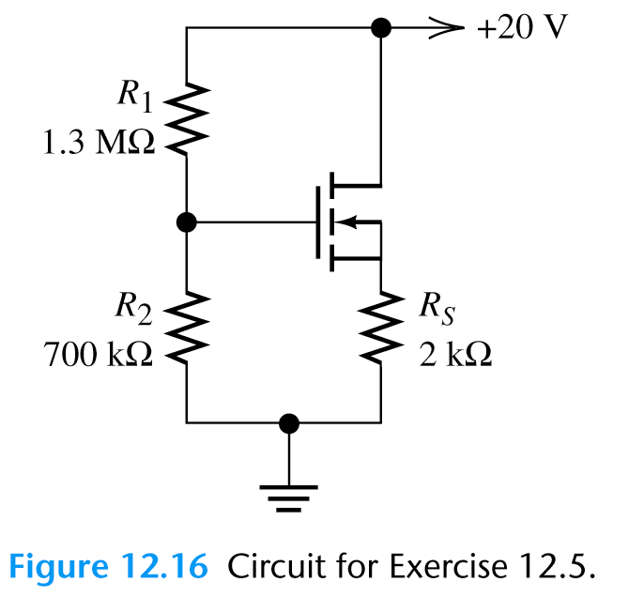
Self Bias Circuits
(For saturation region)
Analyze the self-bias circuit shown. The transistor has K=1mA/V², V_{to}=2V.
find v_{GS}
find i_{D}
find v_{DS}

Slide 30
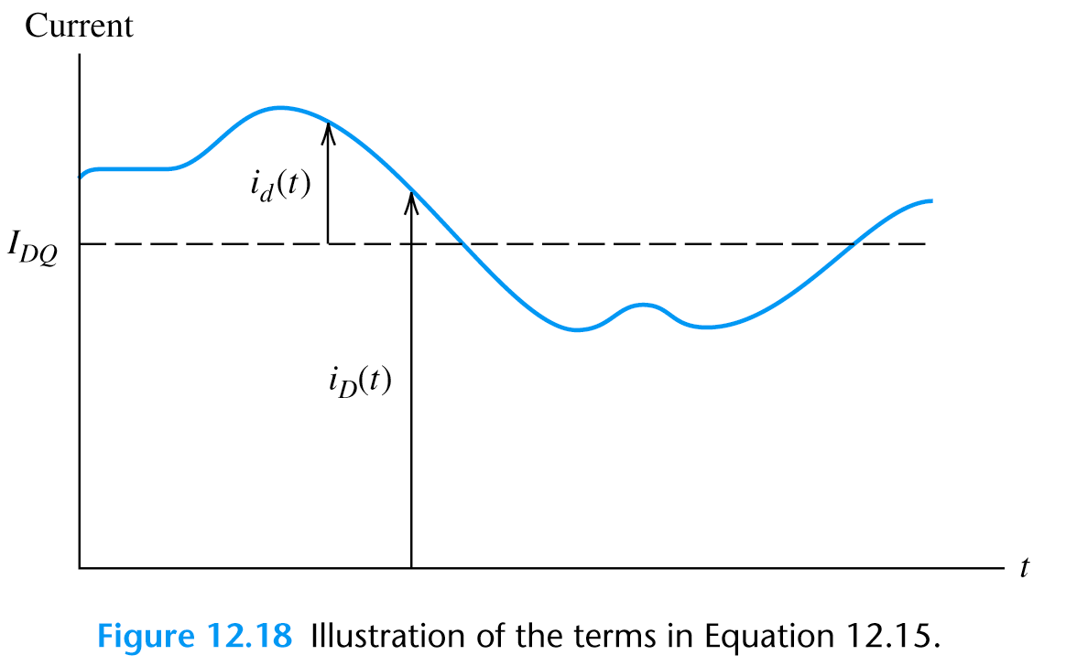
Small-Signal Equivalent Circuit for FETs
Output signal from an amplifier using MOSFET can be effectively modulated by small changes of input signal current. In this way it is possible to make small changes from the Q point.
Symbols:
The total quantities: i_{D}(t), v_{GS}(t)
The DC point values: I_{DQ}, V_{GSQ}
The signal i_{d}(t), v_{gs}(t)
Characteristic

Slide 31
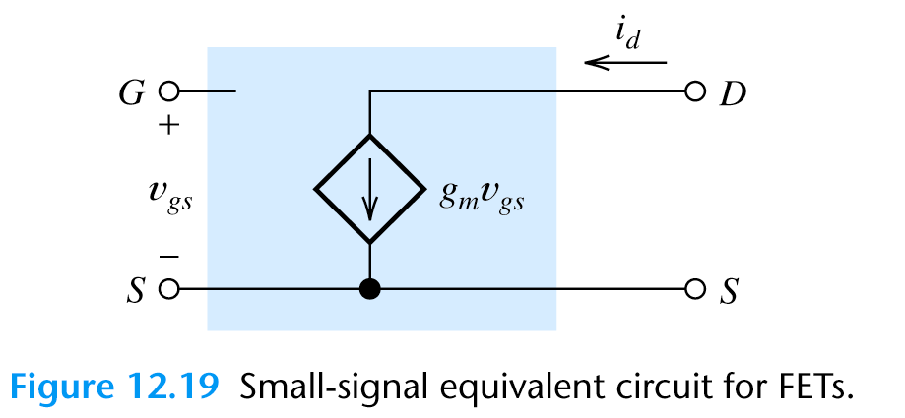
Small-Signal Equivalent Circuit -Transconductance
We define the transconductance as
Schematic

Slide 32
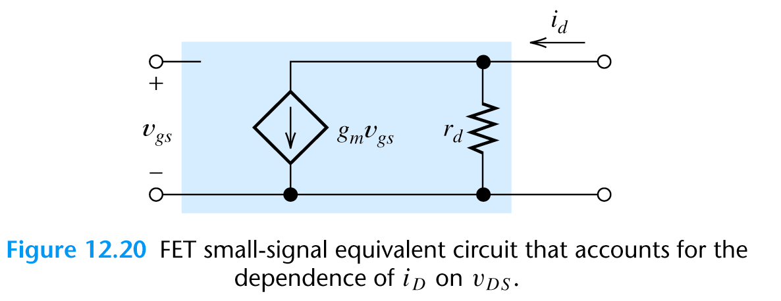
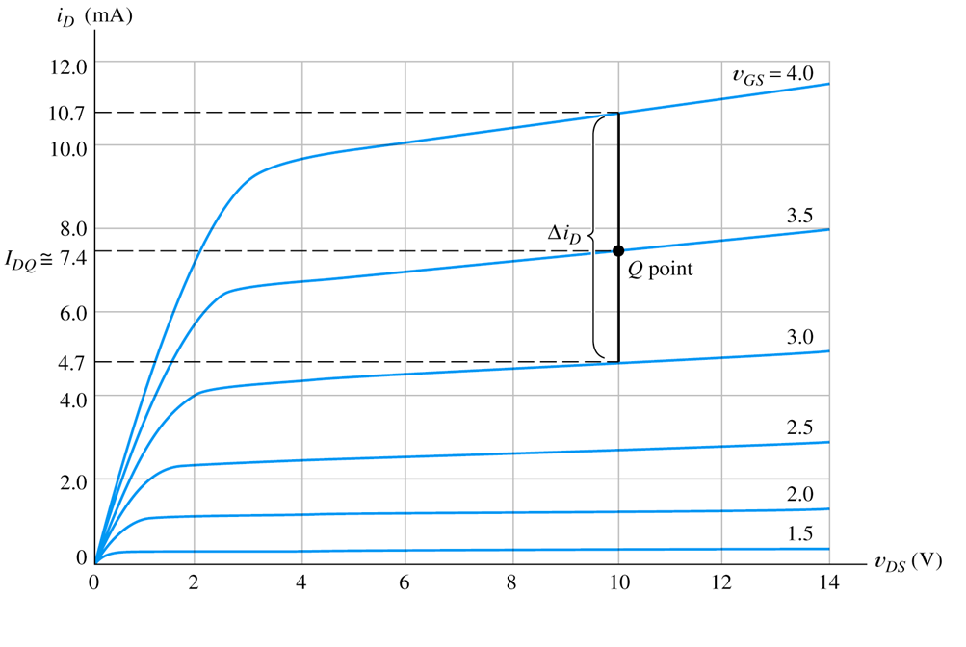
More Complex Equivalent Circuits
For more accurate analyses of FET transistor we have to add more components to an equivalent circuit.
Drain resistor: account for the effect of v_{DS} on the drain current
Correction for i_{d}

Slide 33
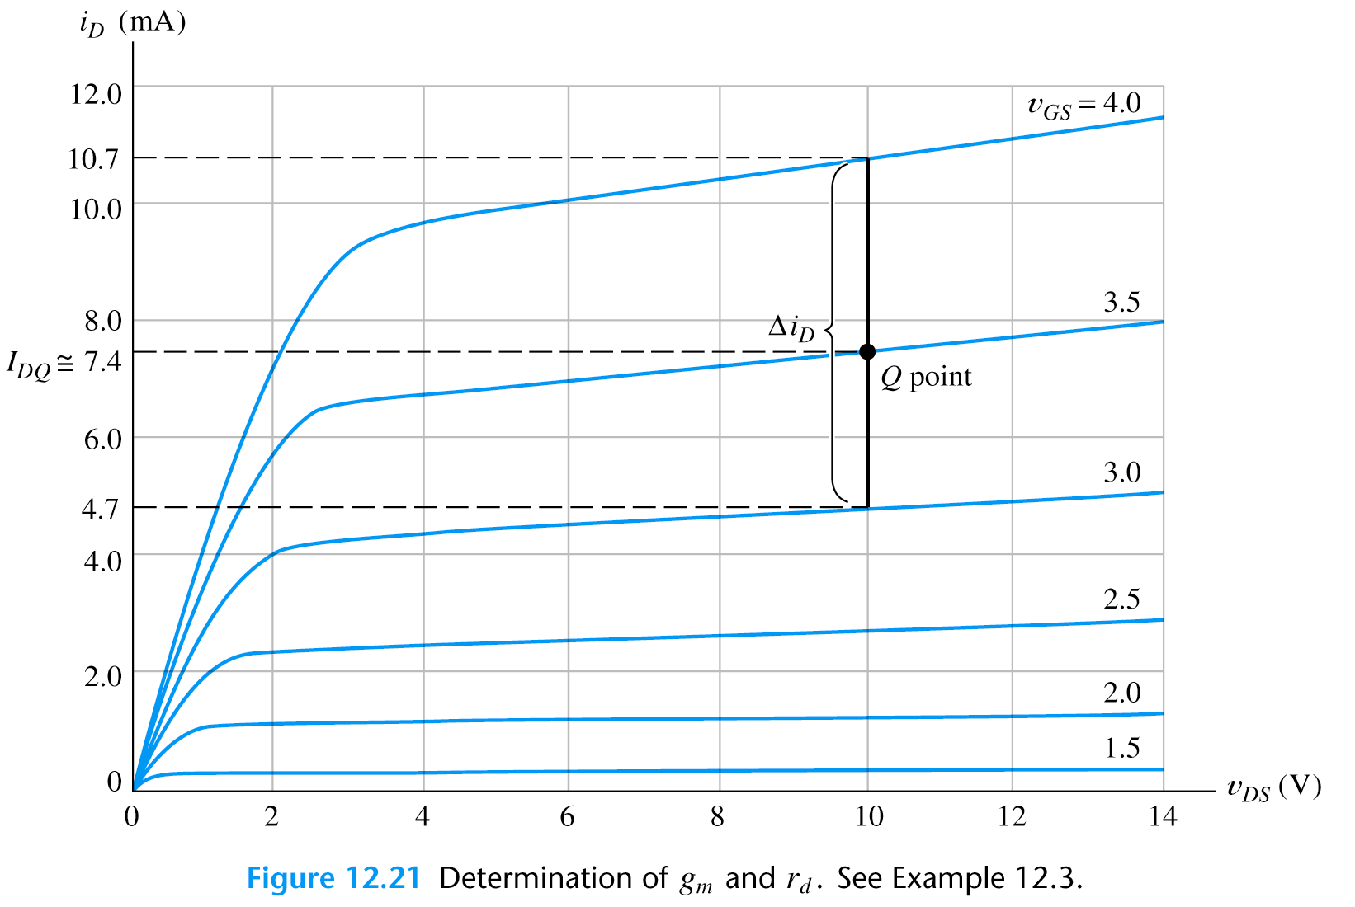
Drain Resistance Calculation
so at v_{GS}=4V

Slide 34
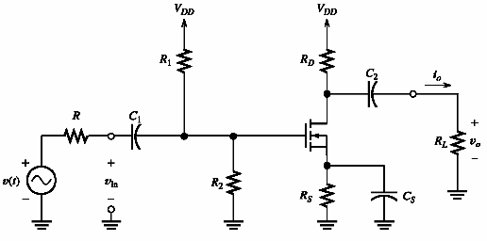
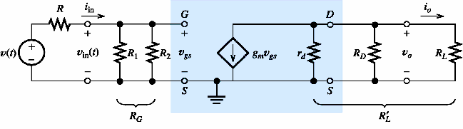
Common-Source Amplifier
Schematic
D
G
S
Equivalent circuit
The dc supply voltage acts as a short circuit for the ac current.

Slide 35
Common-Source Amplifier
C₁, C₂ -coupling C
Schematic
C_{s} -bypass C
ac signal
D
G
S
Equivalent circuit
The dc supply voltage acts as a short circuit for the ac current.

Slide 36

Common-Source Amplifier: Gain, R_{in} and R_{out}
Equivalent circuit (once more)
Input resistance
Voltage gain
From bias point analysis

